Slide 1
Resume Builder and Searcher
Ever feel like you want to make an amazing resume that will just blow away the mind of the hiring company? Ever feel like you want to showcase your amazing achievements in the most stylish fashion? Ever want to make your parents proud of the company you have joined? Resume Builder and Searcher is the right application for you.

Slide 2
Resume Builder and Searcher
Loads of stylish templates, different download formats, video tutorials, progress bar and much much more. Built using the web2py framework, Resume Builder and Searcher provides seemless searching of interesting resumes based on skills, CGPA cutoffs, etc. Building and searching a resume has never been this easy. What are you waiting for? Build your dream resume now.

Slide 3
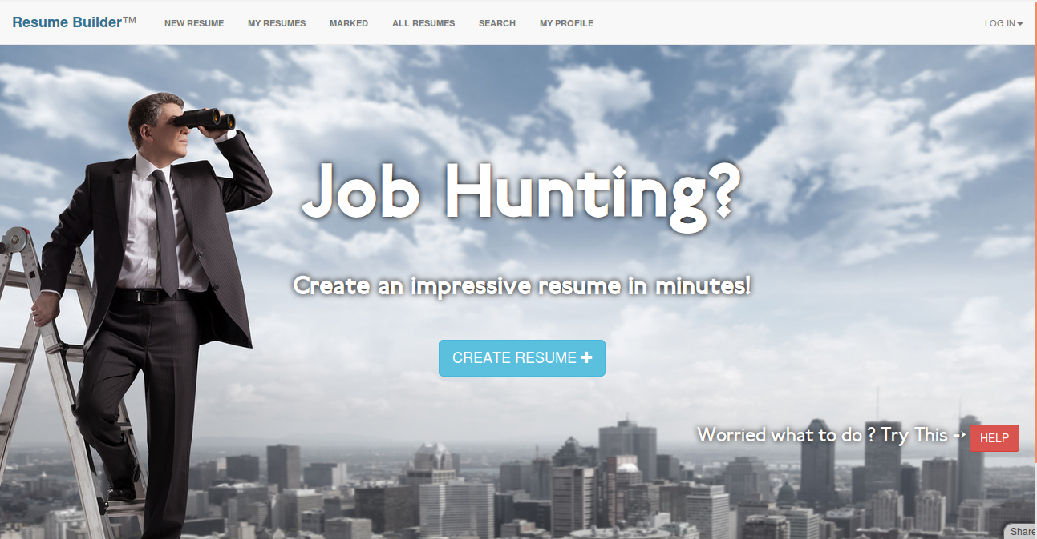
Stylish home page

Slide 4
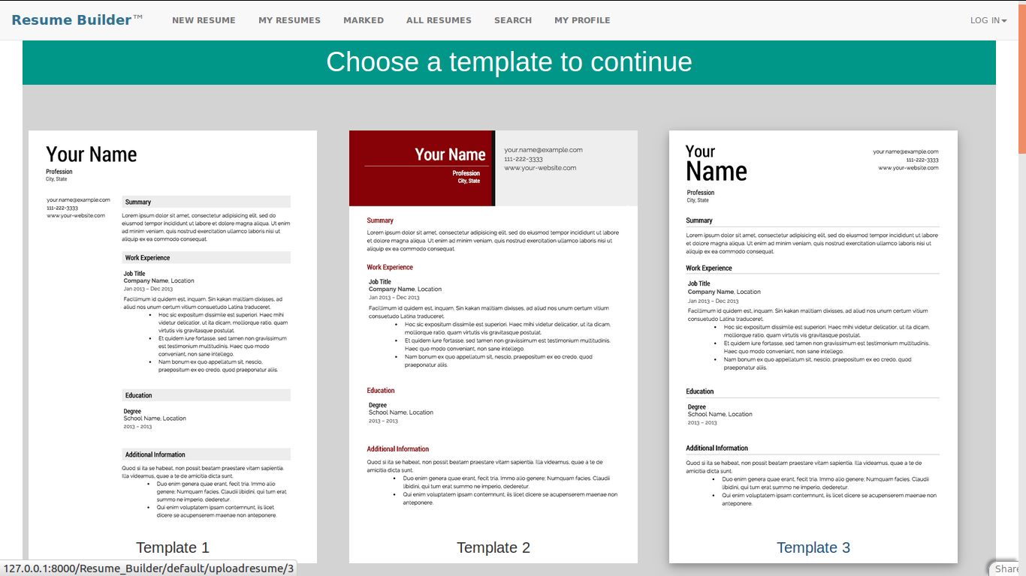
Beautiful looking templates

Slide 5
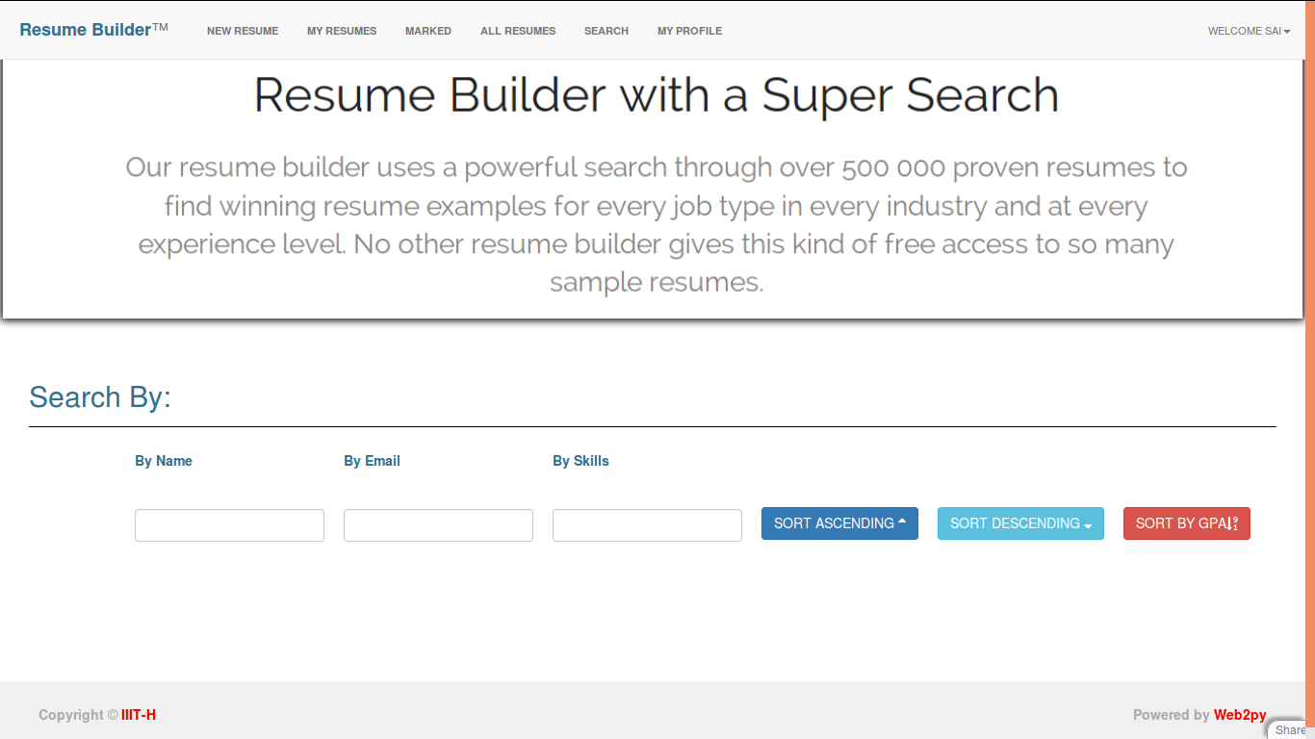
Powerful Search Algorithm

Slide 6
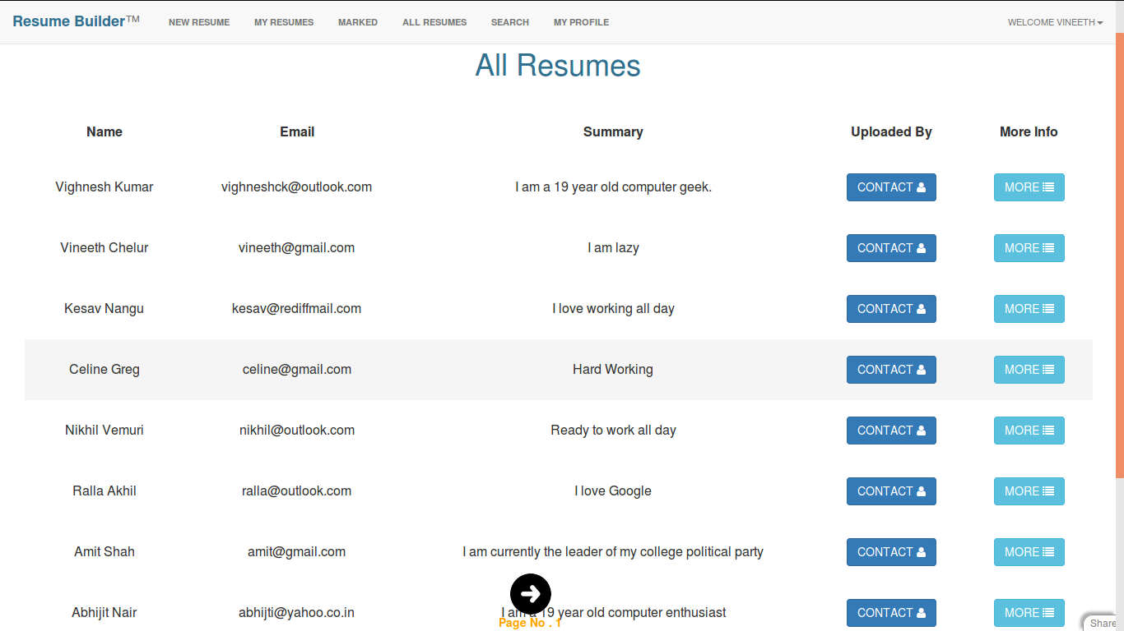
View everyone’s resume

Slide 7
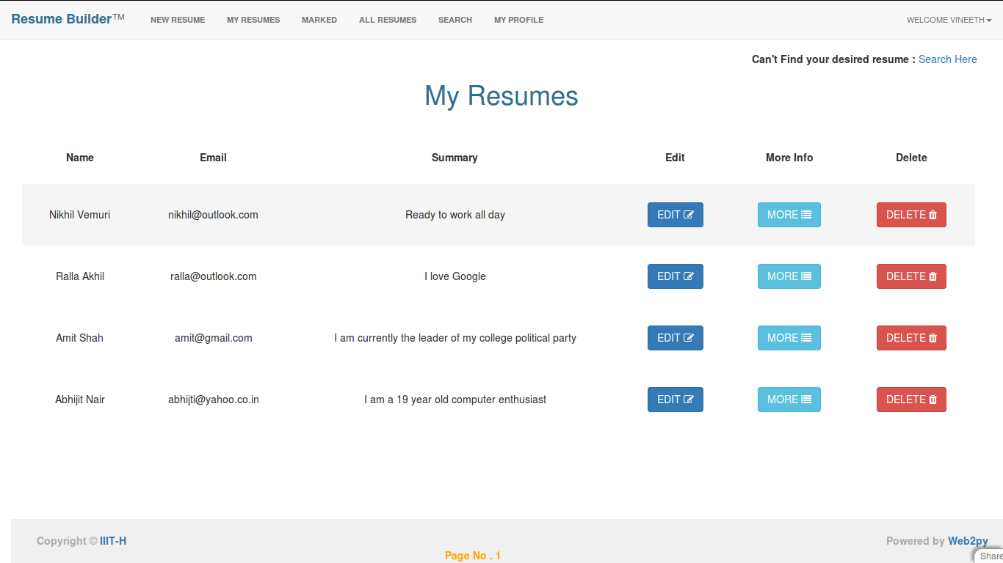
View/Edit/Delete your resumes

Slide 8
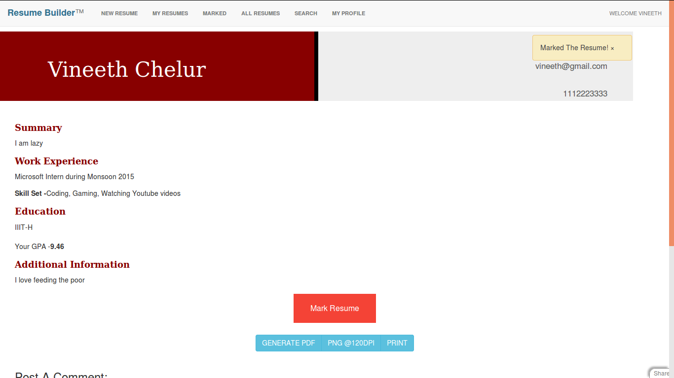
Mark Interesting Resumes

Slide 9

Sign up as an Individual

Slide 10

Sign up as an Organization

Slide 11
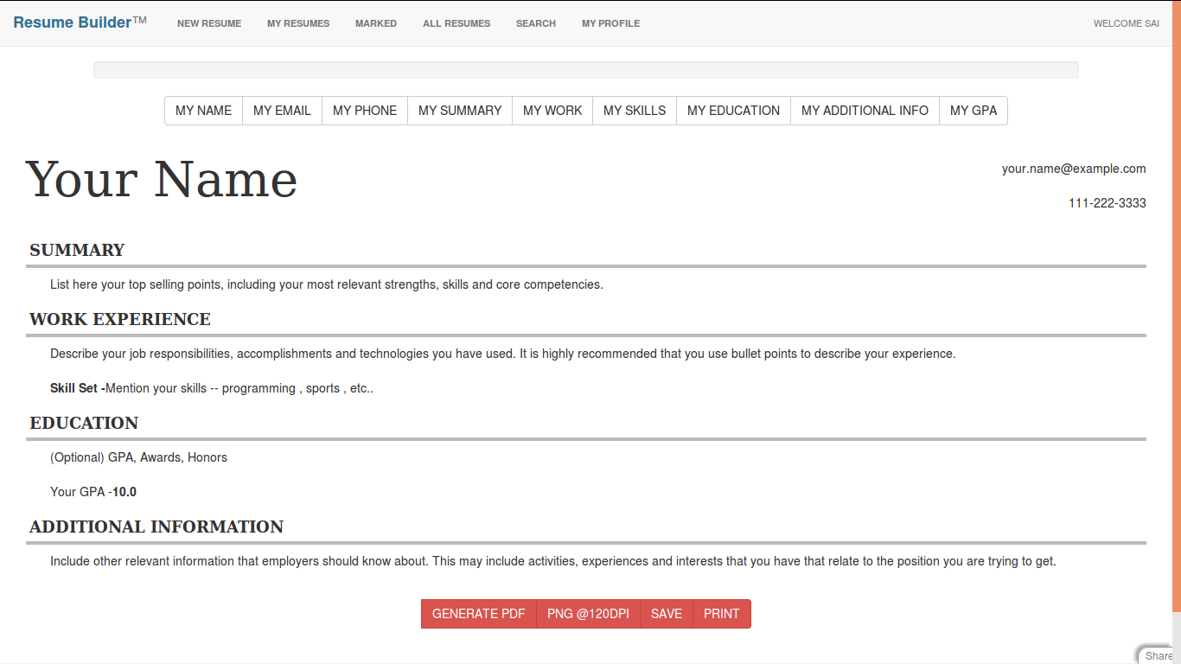
Simple and elegant design

Slide 12
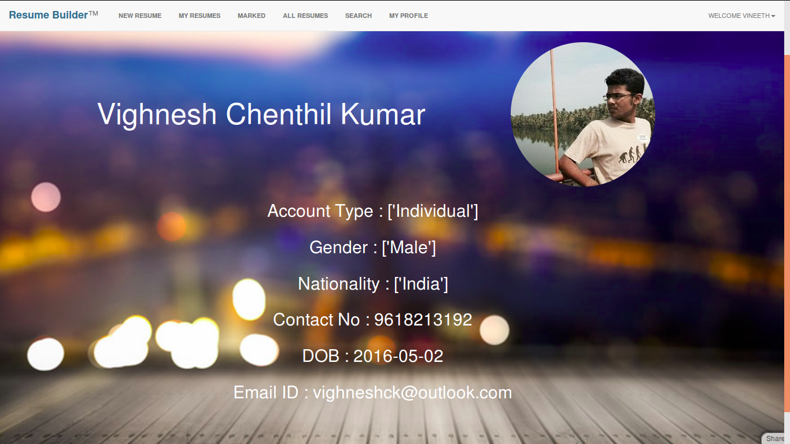
Check profiles

Slide 13
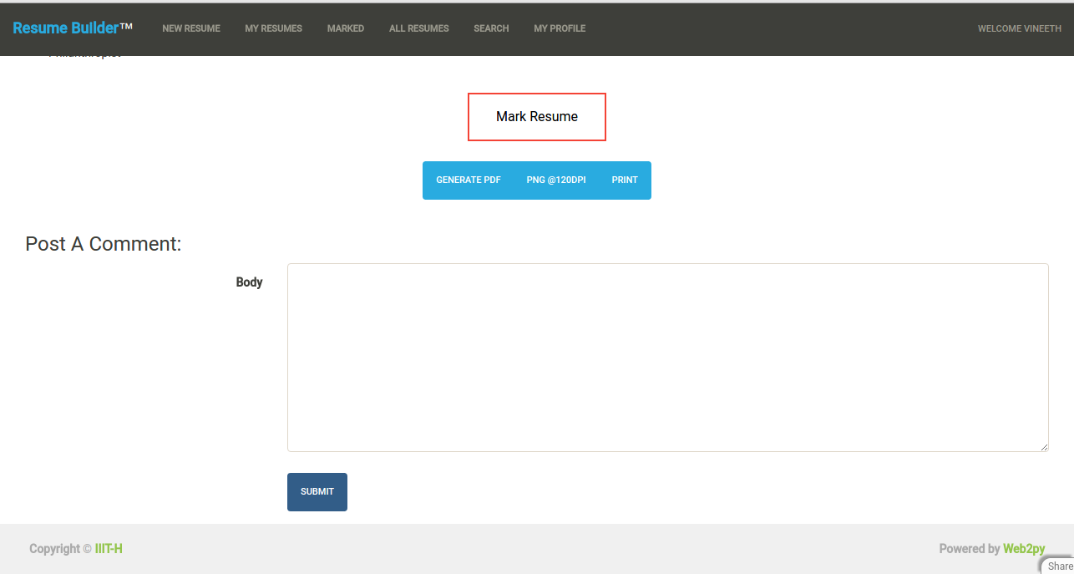
View/Comment others’ resumes in any template

Slide 14
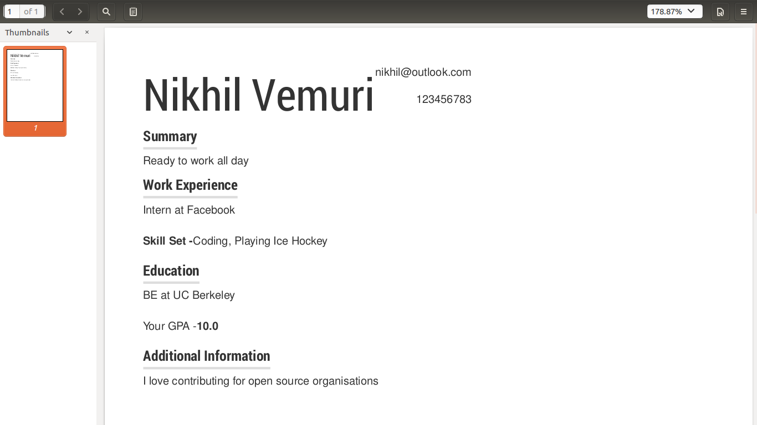
Generate a PDF or print the resume

Slide 15
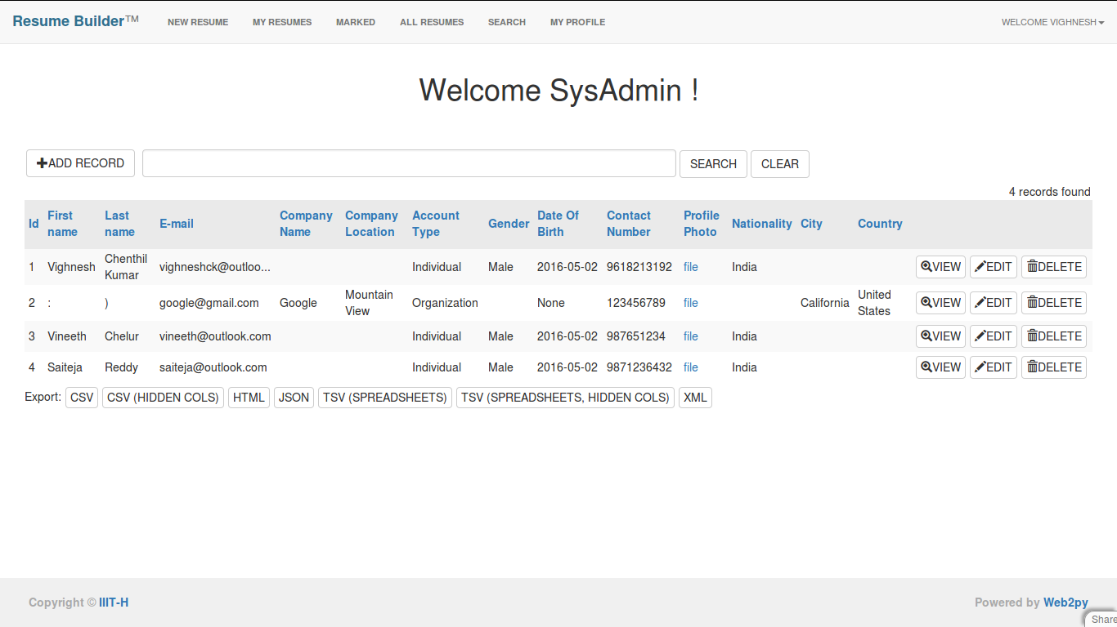
Admin privilege

Slide 16
THANK YOU

